Slide 1
Operators
Chapter 2 + 4

Slide 2
Program and data
Next step to focus on is the process (operations)
input data
output data
Keyboard
Mouse
Processing
Screen
Printer

Slide 3
Operators
Arithmetic Operators
Relational and Equality Operators
Logical Operators

Slide 4
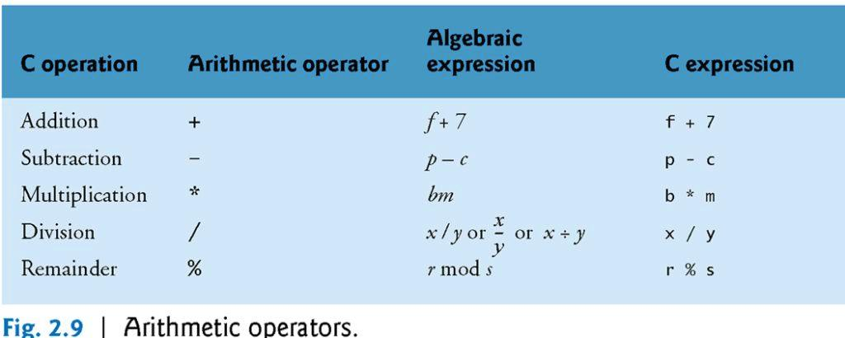
Arithmetic operators

Slide 5
Arithmetic operators
Most programs perform calculations and processing using the C++ arithmetic operators
Note the use of various special symbols not used in algebra
operators +, -, *, and / are used with both int and float data types

Slide 6
Arithmetic operators: remainder operator %
C++ provides the remainder operator %, which yields the remainder after integer division
The remainder operator is an integer operator that can be used only with integer operands
The expression x % y yields the remainder after x is divided by y
Examples:
  7 % 4 = 3
  17 % 5 = 2

Slide 7
Arithmetic operators : Integer division and float division
Integer division (both operands are int) yields an integer result
  The expression 7 / 4 evaluates to 1
  The expression 17 / 5 evaluates to 3
Float division (one or both of the operands is float) yields a float result
Example:
float a = 5.0, b = 2.0;
int c = 5, d = 2;
Then in C++ programming:
  a/b evaluates to 2.5 // Because both operands are float variables
  a/d evaluates to 2.5 // Because one operand is float variable
  c/b evaluates to 2.5 // Because one operand is float variable
  c/d evaluates to 2 // Because both operands are integers

Slide 8
Arithmetic operators: division by zero
An attempt to divide by zero is normally undefined operation on computer systems and generally results in a fatal error, i.e. an error that causes the program to terminate immediately without having successfully performed its job

Slide 9
Arithmetic operators
Parentheses () are used to to group arithmetic expressions
They are used in C++ expressions in the same manner as in algebraic expressions
For example, to multiply a times the quantity b + c we write:
a * ( b + c )

Slide 10
Arithmetic operators: rules of operator precedence
When more than one arithmetic operator is used in an expression, the order of evaluating them is determined by operator precedence rules applies by C++
They are generally the same as those in algebra

Slide 11
Arithmetic operators: rules of operator precedence
1. Parentheses
Highest level of precedence
Operators in expressions contained within pairs of parentheses are evaluated first
the In cases of nested parentheses, such as
    d * ( ( a + b ) - c ) the operators in the innermost pair of parentheses are applied first

Slide 12
Arithmetic operators
  2. Multiplication, division and remainder
  Evaluated second.
  Have the same level of precedence.
  If an expression contains several multiplication, division and remainder operations, evaluation proceeds from left to right.
  3. Addition and subtraction
  Evaluated third.
  Have the same level of precedence.
  If an expression contains several addition and subtraction operations, evaluation proceeds from left to right
  4. Assignment operator (=) is evaluated last

Slide 13
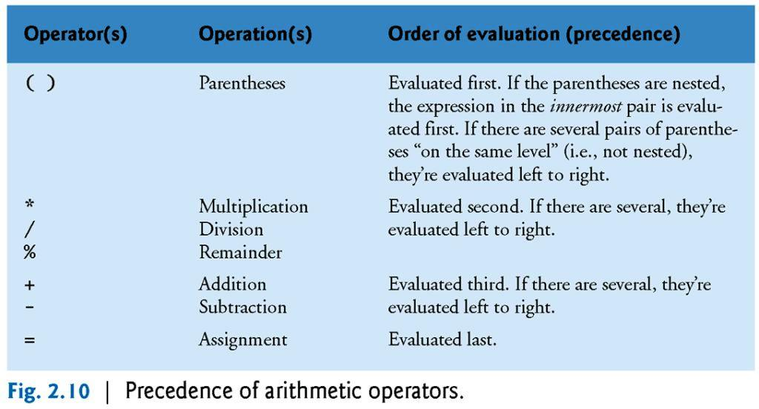
Arithmetic operators precedence

Slide 14
Arithmetic operators
What is the result of the following expression?
num = 3 * 7 – 6 + 2 * 5 / 4 + 6
num = 21 – 6 + 2 * 5 / 4 + 6
num = 21 – 6 + 10 / 4 + 6
num = 21 – 6 + 2 + 6
num = 15 + 2 + 6
num = 17 + 6
num = 23

Slide 15
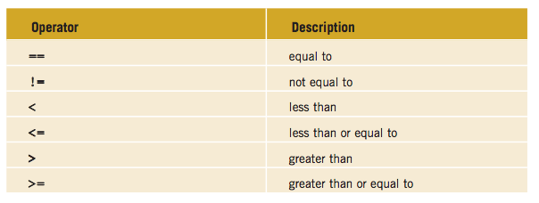
Relational and equality operators
LOWER
HIGHER

Slide 16
Relational and equality operators
1. Relational operators
Have the same level of precedence
Evaluated from left to right
2. Equality operators
Have a lower level of precedence than the relational operators
Evaluated from left to right

Slide 17
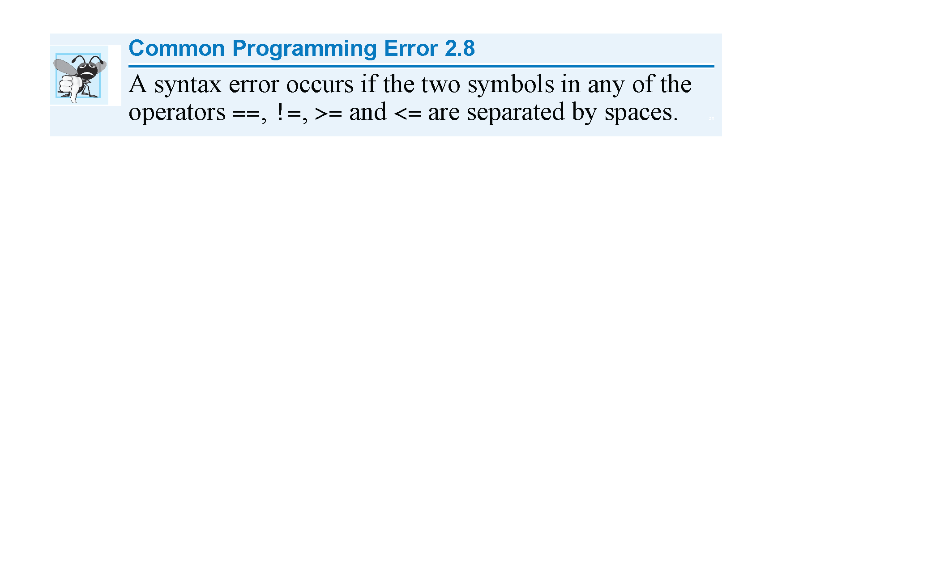
Relational and equality operators

Slide 18
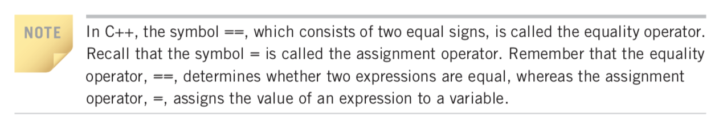
Relational and equality operators

Slide 19
Relational and equality operators
Examples:
  cout << (5 > 2 != 1);
  cout << (2 != 1 > 5);
  cout << (0 == 3 < 9 != 1);
Remember that in C++, true is set to 1 and false is set to 0
0
1
1

Slide 20
Comparing characters
Relational operators and equality operators can be applied to characters
Characters are compared using the ASCII code

Slide 21
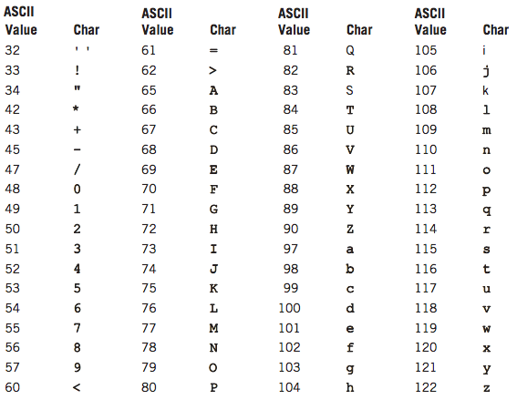
Comparing characters
Expression | value
‘R’ > ‘T’ | false
‘+’ > ‘*’ | true
‘A’ < ‘a’ | true
‘D’ == ‘d’ | false

Slide 22
Comparing strings
Relational operators and equality operators can be applied to strings
Strings are compared character by character, starting with the first character using the ASCII code

Slide 23
Comparing strings
Examples:
string str1 = “Hello”, str2 = “Hi”, str3 = “Air” str4 = “Bill”;
*You can find the explanation on textbook page 180-181
Expression | Value
str1 < str2 | true
str1 > “Hen” | false
str1 == “hello” | false
str3 <= str4 | true
str2 > str4 | true
str4 >= “Billy” | false

Slide 24
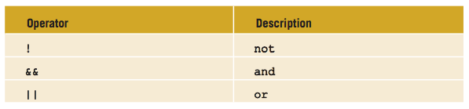
Logical operators
Logical operators enable you to combine logical expressions (expressions that are evaluated to true or false).
Logical operators take only logical values as operands and yield only logical values as results.

Slide 25
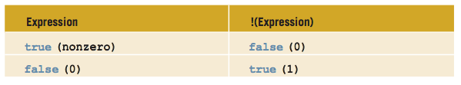

Logical operators: ! (not)
Examples:

Slide 26
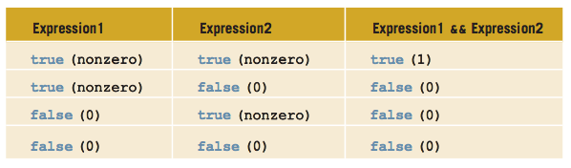
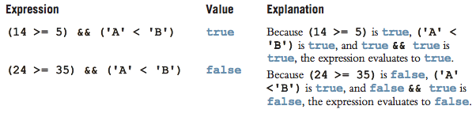
Logical operators: && (and)
Examples

Slide 27
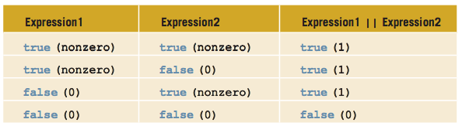
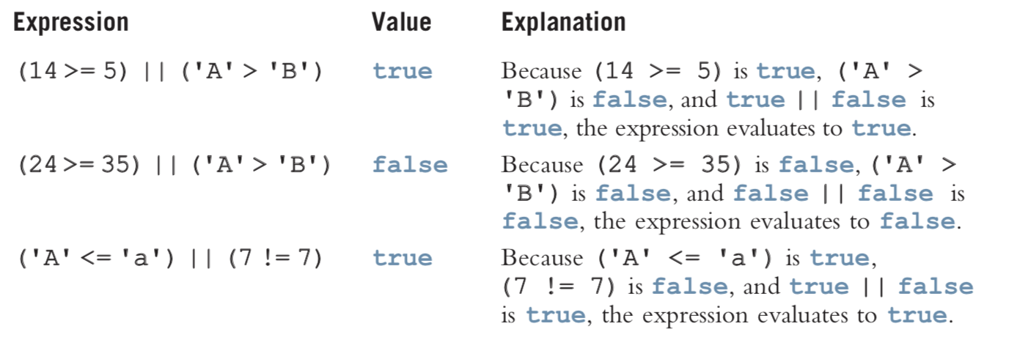
Logical operators: || (or)
Examples:

Slide 28
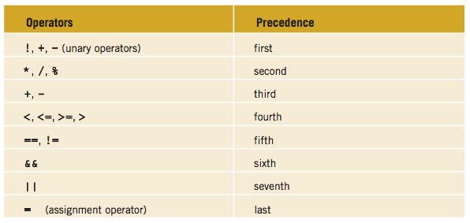
Rules of precedence: All operators
Lists of arithmetic, relational, equality and logical operations from highest to lowest the precedence Operators
Note that the equals sign is also an operator.

Slide 29
Examples )all operators(
cout << 5.4 * 2 - 13.6 + 18 / 2;
cout << (5 + 3 >= 9 && 2 < 3);
6.2
0

Slide 30
Assignment operator
The assignment statement takes the following form:
leftSide = rightSide;
In an assignment statement, the value of the right side should match the data type of the left side.
If the right side is an expression, it should be evaluated first, and its value is assigned to the left side (and thus to the memory location)
Examples:
  int i = 1;
  int first = i;
  int sum = firstNumber + secondNumber;
It is always a variable identifier.
It is either a literal, variable identifier or expression.

Slide 31
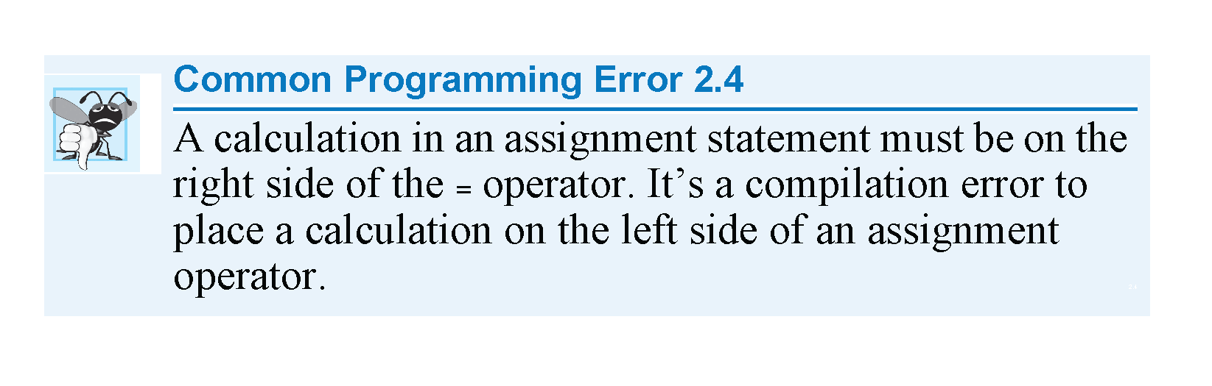
Assignment operator
firstNumber + secondNumber = sum;

Slide 32
Compound assignment operator
C++ provides five compound Assignment operators:
In general,
variable = variable op (expression);
Can be written as:
variable op= expression;
*where op can be +, -, *, / and %
Compound Assignment | Expression | Equivalent
+= | x += y | x = x + y
-= | x -= y | x = x - y
*= | x *= y | x = x * y
/= | x /= y | x = x / y
%= | x %= y | x = x % y
Notes:
Int x = 10;
Int y = 5;
x = x+y; // x=10+5; -> x=15;
X+=y; x=x+y;

Slide 33
Compound assignment operator
Examples
Statement with Simple Assignment Operator | Equivalent statement with Compound Assignment Operator
i = i + 5; | i += 5;
time = time – 1; | time -= 1;
amount = amount * (interest + 1); | amount *= interest + 1;
x = x / (y + 5); | x /= y + 5;
n = n + x + 1; | n += x + 1;
a = a % b; | a %= b;
num = num * num | num *= num
Notes:
Num = *num

Slide 34
Increment operator
The statement
counter = counter + 1;
May be written as
counter += 1;
Or just simply as
counter++; // post-increment (after the operand)
Or as
++counter; // pre-increment (before the operand)
Both post-increment and pre-increment update the variable count and increase its original value by 1

Slide 35
Decrement operator
The statement
counter = counter - 1;
May be written as
counter -= 1;
Or just simply as
counter--; // post-decrement (after the operand)
Or as
--counter; // pre-decrement (before the operand)
Both post-decrement and pre-decrement update the variable count and decrease its original value by 1

Slide 36
Post-inc/dec and pre-inc/dec operators
Pre-increment: The value is incremented by 1 first, then the new value is used.
Post-increment: The original value is used first, then it is incremented by 1.
The same applies for the pre-decrement and post-decrement operators.

Slide 37
Post-inc/dec and pre-inc/dec operators
Assume the initial value of i is 2. Consider the following expressions:
Expression | Explanation | Equivalent to | Values after
j = ++i; | increment i first, then use it (assign i) | i = i + 1; j = i; | i = 3 j = 3
j = i++; | Use i first (assign i), then increment it | j = i; i = i + 1; | j = 2 i = 3
j = 2 + (++i); | increment i first, then use it (add i) | i = i +1; j = 2 + i; | i = 3 j = 5
j = 2 + (i++); | Use i first (add i), then increment it | j = 2 + i; i = i + 1; | j = 4 i = 3
cout << (++i); | increment i first, then use it (print i) | i = i + 1 cout << i; | i = 3 Output: 3
cout << (i++); | Use i first (print i), then increment it | cout << i; i = i + 1 | Output: 2 i = 3

Slide 38
Memory concept
Suppose that num1, num2, and num3 are int variables that correspond to locations in the computer’s memory and the following statements are executed in sequence:
  num1 = 18;
  num1 = num1 + 27;
  num2 = num1;
  num3 = num2 / 5;
  num3 = num3 / 4;
Let us see how the values of the variables (i.e. memory locations) change after the execution of each statement.

Slide 39
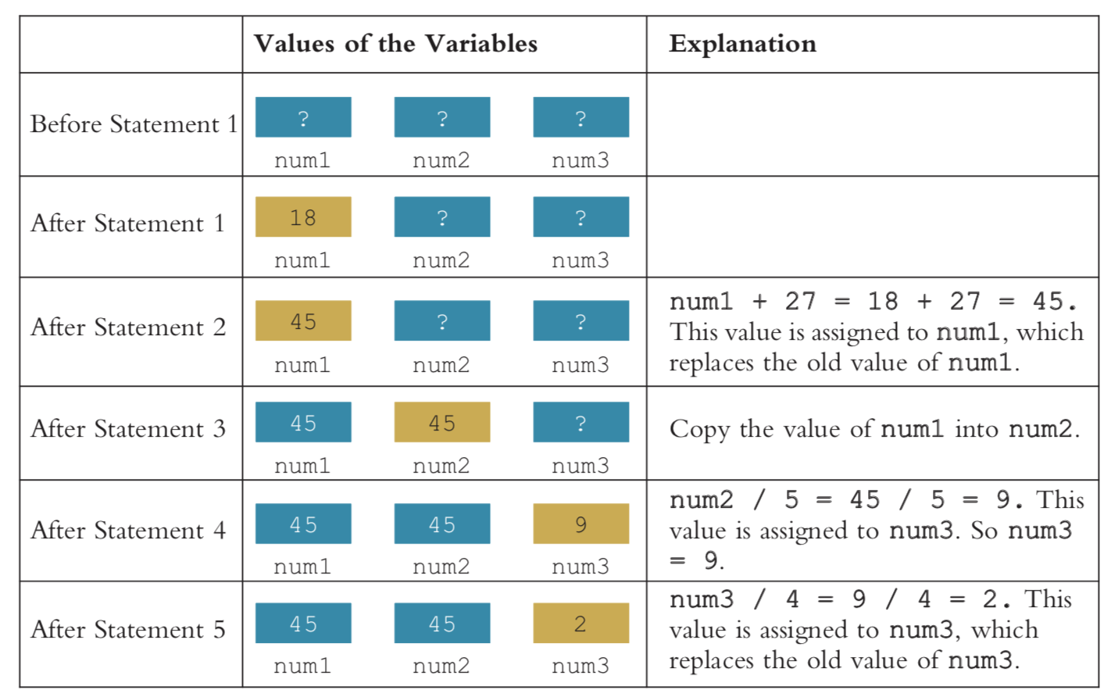
Memory concept
  num1 = 18;
  num1 = num1 + 27;
  num2 = num1;
  num3 = num2 / 5;
  num3 = num3 / 4;

Slide 40
Type casting
Implicit type casting: When a value of one data type is automatically changed to another data type
Example:
float sum;
int x = 2;
sum = x + 7.5;
→ sum = 2.0 + 7.5
→ sum = 9.5

Slide 41
Type casting
Explicit type casting: done through type casting (using the cast operator)
Syntax:
static_cast<dataTypeName>(literal OR variable OR expression)
If expression, it gets evaluated first then the value is converted to a value of the type specified by dataTypeName

Slide 42
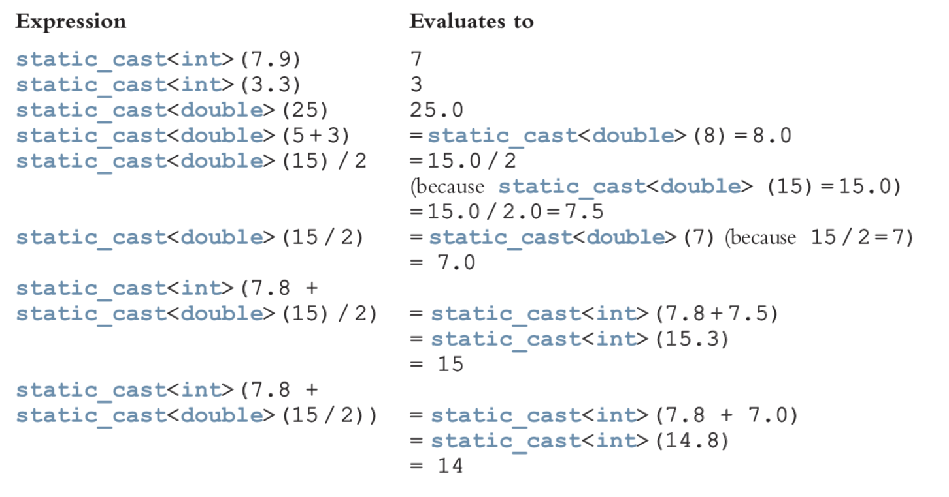
Type casting
Examples:

